Slide 1
5.1 JavaScript Execution Environment
- The JavaScript Window object represents the
window in which the browser displays documents
- The Window object provides the largest enclosing
referencing environment for scripts
- All global variables are properties of Window
- Implicitly defined Window properties:
- document - a reference to the Document object
that the window displays
- frames - an array of references to the frames of
the document
- Every Document object has:
- forms - an array of references to the forms of the
document
- Each Form object has an elements array, which
has references to the form’s elements
- Document also has anchors, links, & images

Slide 2
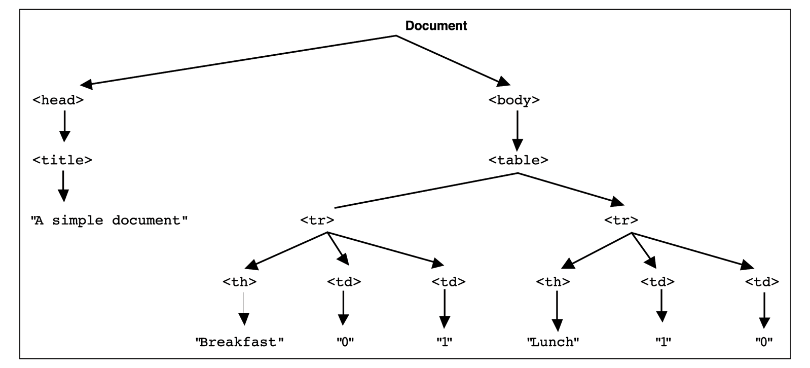
5.2 The Document Object Model
- DOM 0 is supported by all JavaScript-enabled
browsers (no written specification)
- DOM 1 was released in 1998
- DOM 2 is the latest approved standard
- The DOM is an abstract model that defines the
interface between HTML documents and
application programs—an API
→DOM tree

Slide 3
5.2 The Document Object Model
- A language that supports the DOM must have a
binding to the DOM constructs
- In the JavaScript binding, HTML elements are
represented as objects and element attributes
are represented as properties
e.g., <input type = "text" name = "address">
would be represented as an object with two
properties, type and name, with the values
"text" and "address"

Slide 4
5.3 Element Access in JavaScript
- There are several ways to do it
- Example (a document with just one form and
one widget):
<form action = "">
<input type = "button" name = "pushMe">
</form>
1. DOM address
document.forms[0].element[0]
Problem: document changes
2. Element names – requires the element and all
of its ancestors (except body) to have name
attributes
- Example:
<form name = "myForm" action = "">
<input type = "button" name = "pushMe">
</form>
document.myForm.pushMe
Problem: XHTML 1.1 spec doesn’t allow the
name attribute on form elements

Slide 5
5.3 Element Access in JavaScript
(continued)
3. getElementById Method (defined in DOM 1)
- Example:
<form action = "">
<input type = "button" id = "pushMe">
</form>
document.getElementById("pushMe")
- Checkboxes and radio button have an implicit
array, which has their name
<form id = "topGroup">
<input type = "checkbox" name = "toppings"
value = "olives" />
...
<input type = "checkbox" name = "toppings"
value = "tomatoes" />
</form>
...
var numChecked = 0;
var dom = document.getElementById("topGroup");
for index = 0; index < dom.toppings.length;
index++)
if (dom.toppings[index].checked]
numChecked++;

Slide 6
5.4 Events and Event Handling
- An event is a notification that something specific
has occurred, either with the browser or an action
of the browser user
- An event handler is a script that is implicitly
executed in response to the appearance of an event
- The process of connecting an event handler to an
event is called registration
- Don’t use document.write in an event handler,
because the output may go on top of the display
Event Tag Attribute
blur onblur
change onchange
click onclick
focus onfocus
load onload
mousedown onmousedown
mousemove onmousemove
mouseout onmouseout
mouseover onmouseover
mouseup onmouseup
select onselect
submit onsubmit
unload onunload

Slide 7
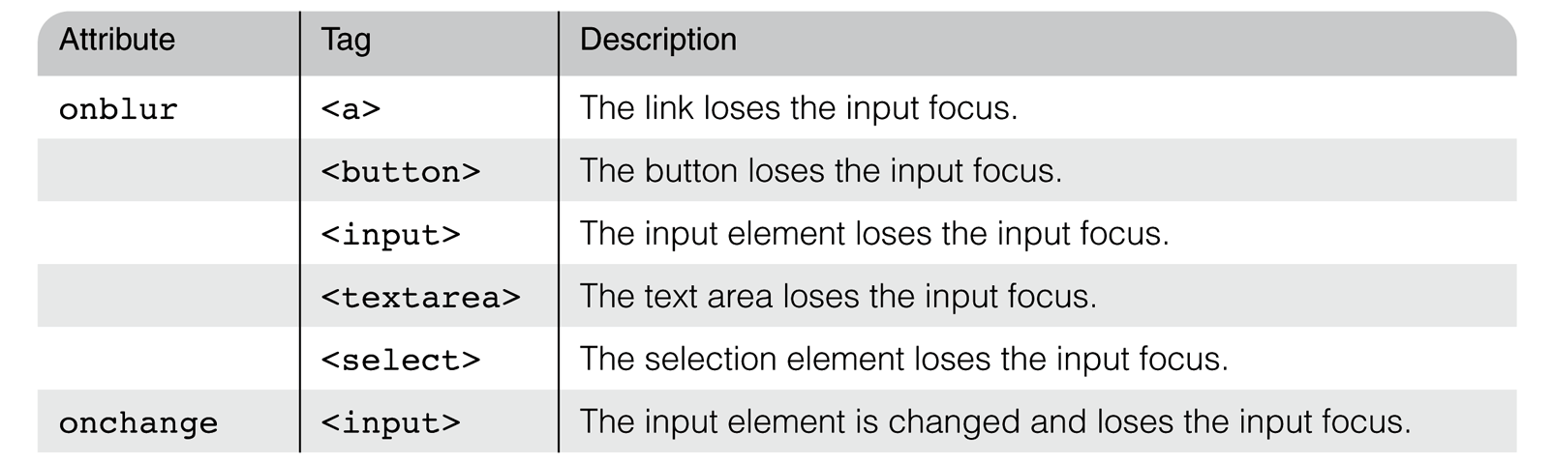
5.4 Events and Event Handling
(continued)
- The same attribute can appear in several different
tags
e.g., The onclick attribute can be in <a> and
<input>
- A text element gets focus in three ways:
1. When the user puts the mouse cursor over it
and presses the left button
2. When the user tabs to the element
3. By executing the focus method

Slide 8
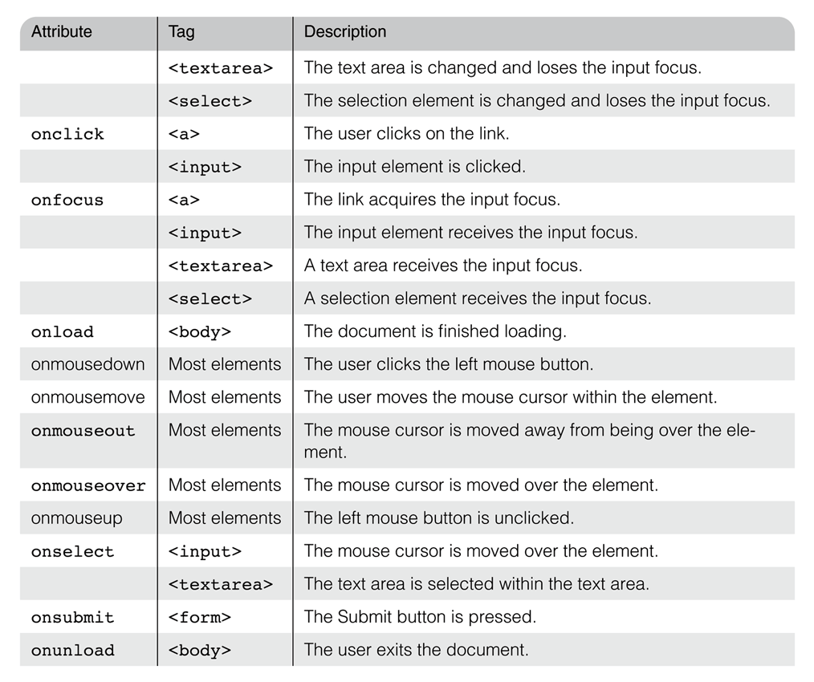
5.4 Events and Event Handling
(continued)
- Event handlers can be registered in two ways:
1. By assigning the event handler script to an event
tag attribute
onclick = "alert('Mouse click!');"
onclick = "myHandler();"
1

Slide 9
5.5 Handling Events from Body
Elements
- Example: the load event - triggered when the
loading of a document is completed
5.6 Handling Events from Button
Elements
- Plain Buttons – use the onclick property
- Radio buttons
- If the handler is registered in the markup, the
particular button that was clicked can be sent
to the handler as a parameter
e.g., if planeChoice is the name of the handler
and the value of a button is 172, use
onclick = ″planeChoice(172)″
- This is another way of choosing the clicked
button

Slide 10
5.6 Handling Events from Button
Elements (continued)
- If the handler is registered by assigning it to a
property of the JavaScript objects
associated with the HTML elements. As in:
var dom = document.getElementById(″myForm″)
dom.elements[0].onclick = planeChoice;
- This registration must follow both the handler
function and the XHTML form
- Note that for the radio buttons,
the checked property is used to
determine whether a
button is clicked
- If the name of the buttons is planeButton
var dom = document.getElementById(″myForm″);
for (var index = 0;
index < dom.planeButton.length; index++) {
if (dom.planeButton[index].checked) {
plane = dom.planeButton[index].value;
break;
}
}
2

Slide 11
5.8 The DOM 2 Event Model
- Does not include DOM 0 features, but they are
still supported by browsers
- DOM 2 is modularized—one module is Events,
which has two submodules, HTMLEvents and
MouseEvents, whose interfaces are Event (blur,
change, etc.) and MouseEvent (click, mouseup, etc.)
- Event propagation
- The node of the document tree where the event
is created is called the target node
- The capturing phase (the first phase)
- Events begin at the root and move toward the
target node
- Registered and enabled event handlers at
nodes along the way are run
- The second phase is at the target node
- If there are registered handlers there for the
event, they are run
- The third phase is the bubbling phase
- Event goes back to the root; all encountered
registered handlers are run

Slide 12
5.8 The DOM 2 Event Model (continued)
- Not all events bubble (e.g., load and unload)
- Any handler can stop further event propagation
by calling the stopPropagation method of the Event
object
- DOM 2 model uses the Event object method,
preventDefault, to stop default operations, such
as submission of a form, if an error has been
detected
- Event handler registration is done with the
addEventListener method
- Three parameters:
1. Name of the event, as a string literal
2. The handler function
3. A Boolean value that specifies whether the
event is enabled during the capturing phase
node.addEventListener(
"change", chkName, false);

Slide 13
5.8 The DOM 2 Event Model (continued)
- A temporary handler can be created by registering
it and then unregistering it with
removeEventListener
- The currentTarget property of Event always
references the object on which the handler is
being executed
- The MouseEvent interface (a subinterface of
Event) has two properties, clientX and
clientY, that have the x and y coordinates of
the mouse cursor, relative to the upper left
corner of the browser window
- An example: A revision of validator, using the
DOM 2 event model
- Note: DOM 0 and DOM 2 event handling can be
mixed in a document

